Slide 1

PRODUCT ANALYSIS AND CUSTOMER LIFETIME VALUE
Group 3:
Harshilkumar Patel
Kishankumar Patel
Rishav Rana

Slide 2

Introduction
Product Analytics is the process of gathering information on the post-purchase experiences of customers who have purchased products.
It starts with gathering information on user trends, the most and least popular features, bounce rates, friction spots, and other aspects of how customers use and interact with a product.
Client lifetime value (CLV), a word that is occasionally used synonymously with customer lifetime value, is a forecast of how much a company's future relationships with customers will contribute to its net profit.

Slide 3
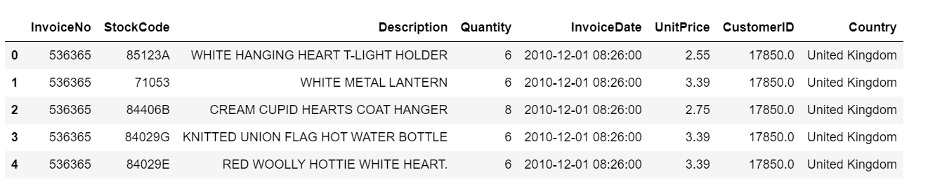
Review of Data Source
The Online Retail.xlsx dataset has 541909 rows and 8 columns.
Each row represents a produced invoice, while the eight columns indicates the Invoice No, Stock Code , Description of the product , Quantity , Invoice Date , Unit Price , Customer ID and Country.

Slide 4
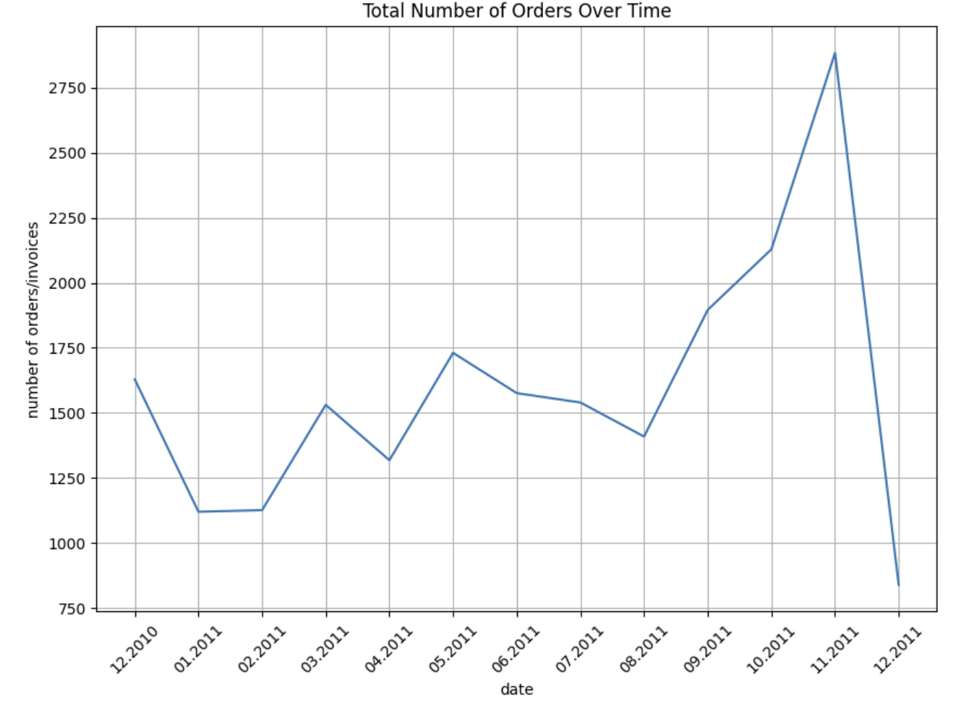
Total Number of Orders Over Time
Insights
The graph shows that the overall trend line of the number of transactions has been increasing from December 2010 to November 2011.
But in the last month of 2011 total number of orders is lowest from December 2010.
Recommendations
During some seasons of the year, transactions may naturally be lower.
As a result, the business should make the necessary preparations, adjust any operational or marketing strategies in accordance with the seasons, and account for these changes.

Slide 5
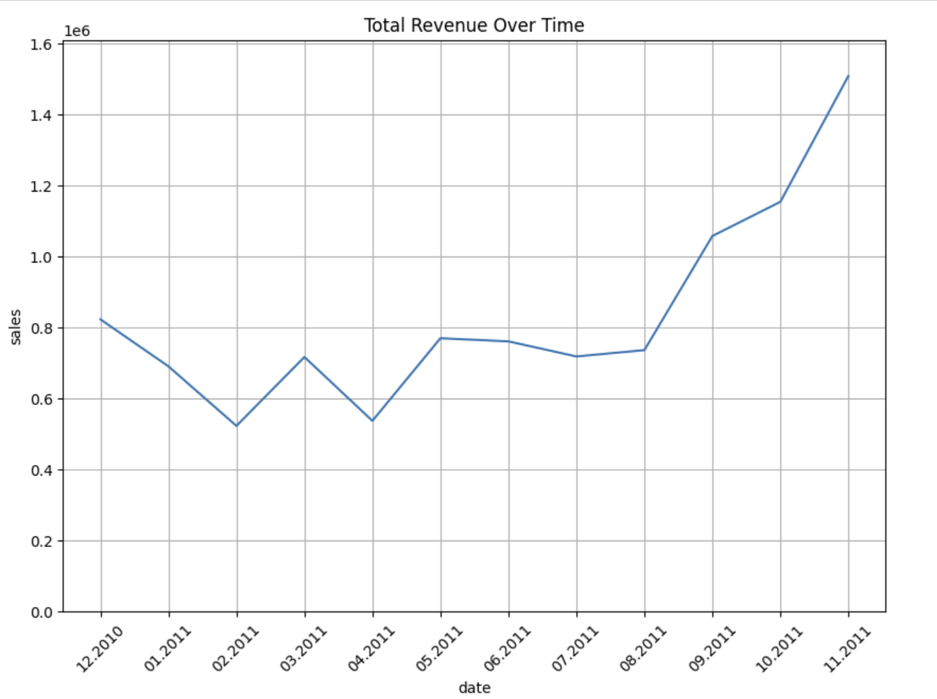
Total Revenue Over Time
Insights
The graph shows that the overall trend line of the sales increased from December 2010 to November 2011.
Like the number of transactions, sales were flat up to April.
Back-to-school caused sales to go up again in September, but Black Friday or Halloween caused them to really take off in October and November.
Recommendations
To increase the sales in the month of January to may their different strategies that company can apply for example offer special deals and promotions that are relevant to the season

Slide 6
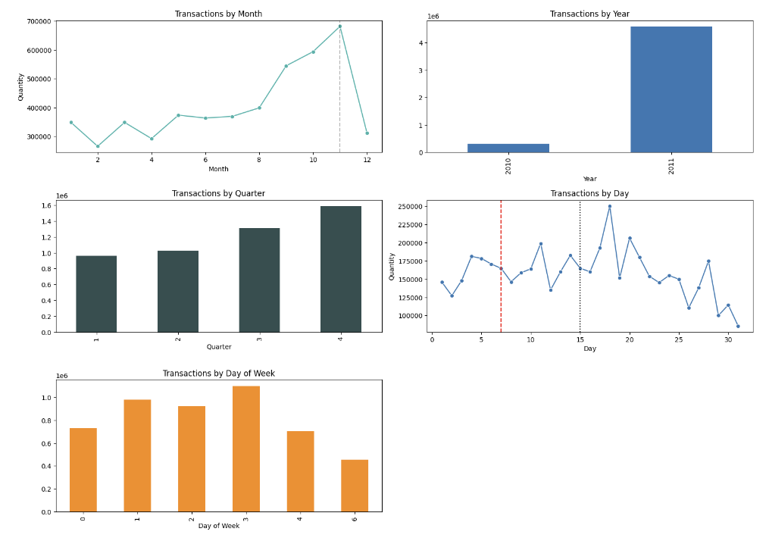
Transaction by time periods
Insights
From the various charts we can see that in 2011 as compared to 2010 there is so many transactions.
In Transaction by months from the month May to August there is steady flow of transaction and in the month of November It is at peak.
In Transaction by days in the mid of every month here is a greater number of transactions and lowest number of transactions at the month end.
Recommendations
Review their pricing strategy and consider changing prices to more closely match market demand and customer preferences.
This may involve giving discounts or promotions for large purchases or encouraging customers to buy more expensive products.

Slide 7
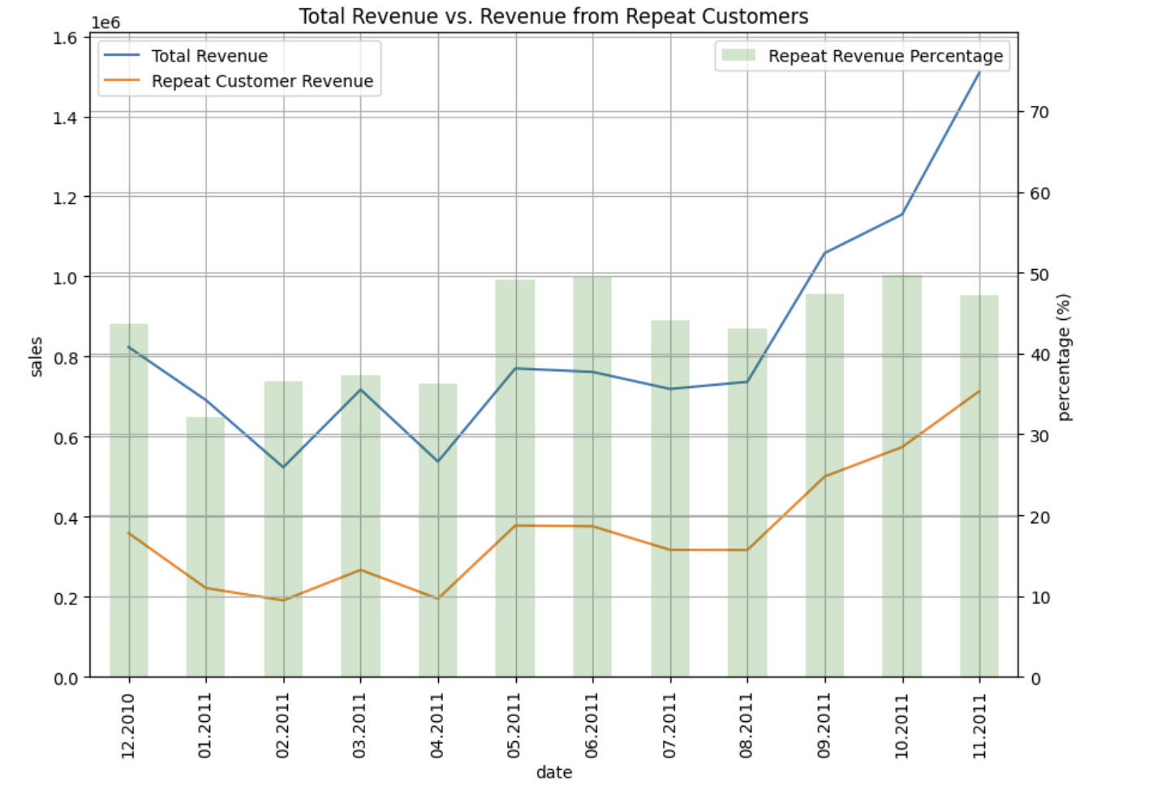
Revenue From Repeat Customers
Insights
Moving on to the revenue section, we can see that by Nov 2011 the revenue generated from repeat customers was half of the entire revenue and on average it was not less than 30%, and by June 2011 it had surpassed 50%.
Recommendations
Use consumer information to generate tailored offers based on previous purchases or browsing activity. This might assist you in adjusting your marketing messages and product suggestions to their tastes and interests.

Slide 8
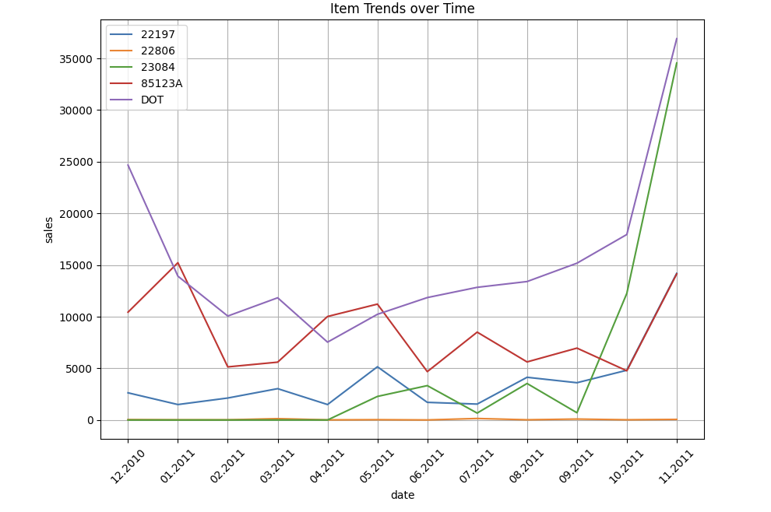
Item Trends over Time
Insights
Here we have analyzed top 5 items over the specific time period the product DOT has been drastically fall from December 2010 to April 2011.
Also, the product 23084 has no trend in the last month of 2010 but after August 2011 we can see that it is at the peak at in November 2011.
Recommendations
As per the graph we assume that the items are seasonal items for example in the DOT product there is not more sale of that product in the winter and after the month of April the sale is increased . So business prepare adjustments, operational or marketing strategies in accordance with the seasons .

Slide 9
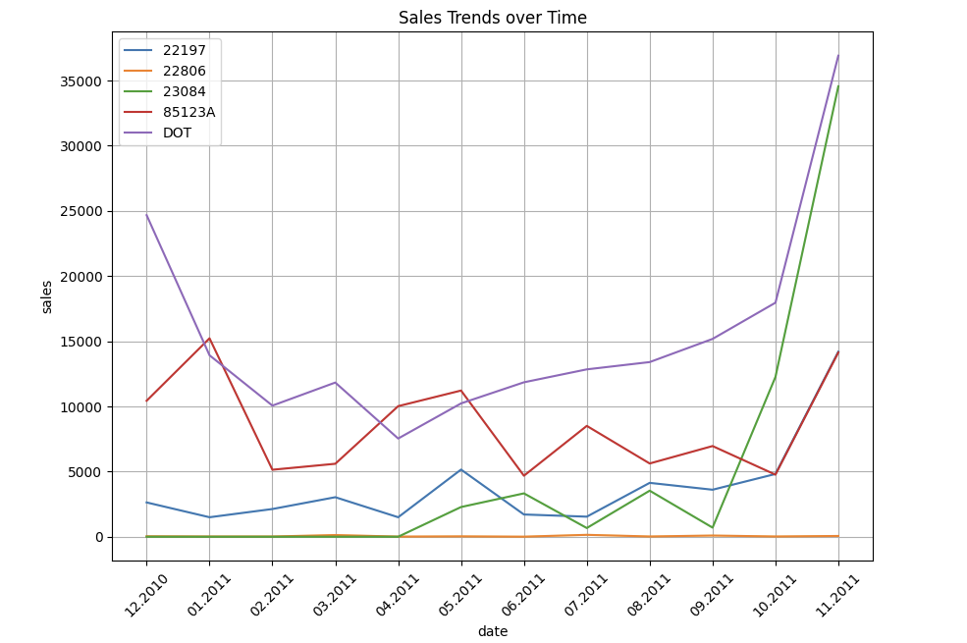
Sales Trend Over Time
Insights
The sale of product 85123A is not stable because it is fluctuating in every two months.
Recommendations
Business owner should find trends and patterns in sales variations, analyse sales data.
This might assist you in modifying your marketing and sales strategy so that they better satisfy customer demand during periods of high sales.

Slide 10
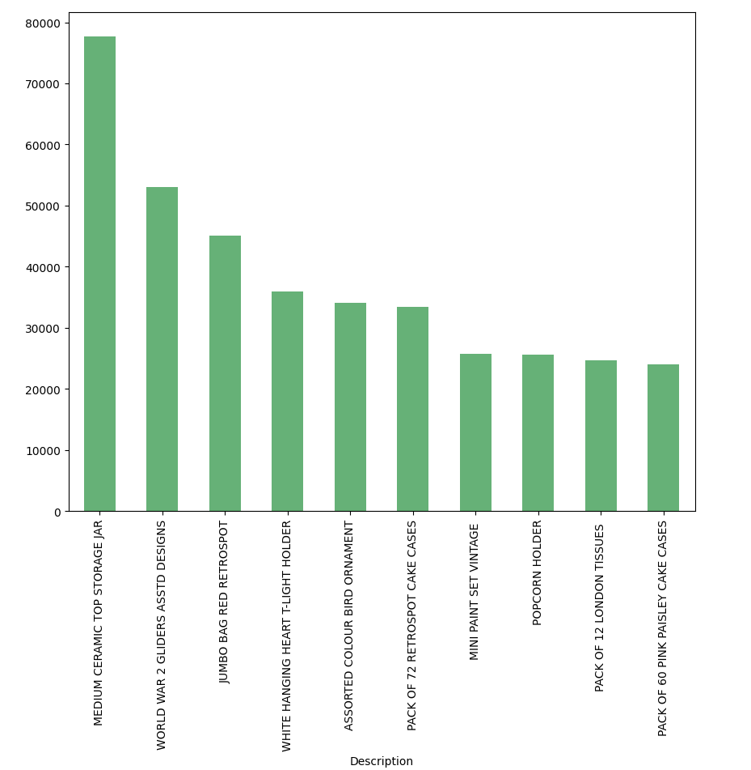
Product Purchases more often
Insights
As we can see in the bar chart the MEDIUM CREAMIC TOP STORAGE JAR is most purchased followed by World WAR 2 GLIDERS ASSTD DESIGNS, JUMBO BAG RED RETRO SPOT while the PACK OF 60 PINK PASLEY CAKE CASES is the least sold.
Recommendations
Share baking tips and recipes that use cake cases on social media sites to highlight the cake cases. The cake containers can be used to inspire customers to contribute their own creations, fostering a sense of community and involvement around your brand to increase the sales of pack of 60 pink pasley cake cases.

Slide 11

Thank you

